Slide 1
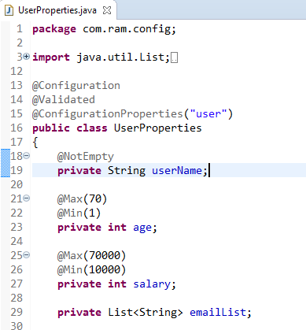
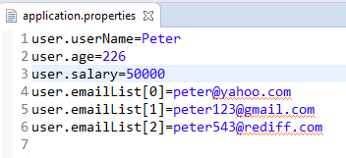
Spring Boot @ConfigurationProperties - Property Validation
The @ConfigurationProperties support JSR-303 bean validation – javax.validation

